Slide 1


Network protocols & security
24EC2210
Topic:
Domain Name System (DNS)
Session - 31

Slide 2
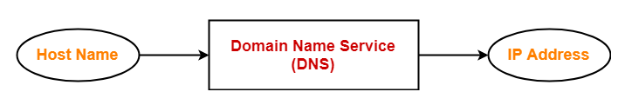
DNS
DNS is short name for Domain Name Service or Domain Name System.
It is an application layer protocol.
Purpose:-
DNS is a host name to IP Address translation service.
It converts the names we type in our web browser address bar to the IP Address of web servers hosting those sites.

Slide 3
DNS
The need for Domain Name Service arises due to the following reasons:
IP addresses are not static and may change dynamically. So, a mapping is required which maps the domain names to the IP Addresses of their web servers.
IP Addresses are a complex series of numbers. So, it is difficult to remember IP Addresses directly while it is easy to remember names.

Slide 4
Types of Domain name spaces
The name assigned to machines must be unique.
Name space map each address to a unique name in two ways
- Flat name space
- Hierarchical name space

Slide 5
Types of Domain name spaces…
Flat name space:
A name in this space is a sequence of characters without structure.
A name may or may not have a common section.
It cannot be used in internet.
Hierarchical name space:
Each name has several parts.
The first part define the nature of the organization.
The second part define the name of the organization.
The third part define departments in the organization and so on.
The central authority assigned only the first two parts of the name space and the rest of parts are assigned organization itself.

Slide 6
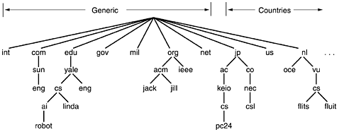
The DNS Name Space
The Internet is divided into over 200 top-level domains, where each domain covers many hosts.
Each domain is partitioned into subdomains, and these are further partitioned, and so on.
All these domains can be represented by a tree, as shown in Figure.

Slide 7
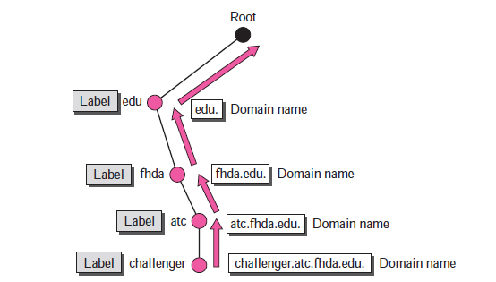
Domain Names and Labels
Each node in the tree has a label, which is a string with a maximum of 63 characters.
The root label is a null string (empty).
A full domain name is a sequence of labels separated by dots.
The domain names are always read from the node up to the root.
Finally, it end with null (root node).

Slide 8
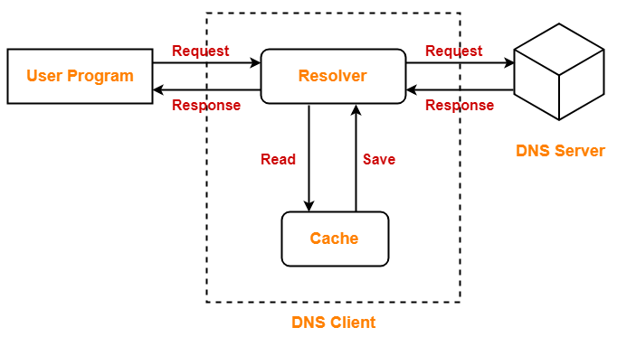
DNS Resolution
DNS Resolution is a process of resolving a domain name onto an IP Address.

Slide 9
DNS Resolution…
The steps involved in DNS Resolution are-
1. A user program sends a name query to a library procedure called the resolver.
2. Resolver looks up the local domain name cache for a match.
If a match is found, it sends the corresponding IP Address back.
If no match is found, it sends a query to the local DNS server.
3. DNS server looks up the name.
If a match is found, it returns the corresponding IP Address to the resolver.
If no match is found, the local DNS server sends a query to a higher level DNS server.
This process is continued until a result is returned.
4. After receiving a response, the DNS client returns the resolution result to the application.

Slide 10

DNS name resolution example
root DNS server
host at cis.poly.edu wants IP address for gaia.cs.umass.edu
2
3
TLD DNS server
Iterated query:
In iterative DNS query, the client communicates directly with each DNS server involved in the lookup.
contacted server replies with name of server to contact
“I don’t know this name, but ask this server”
4
5
local DNS server
dns.poly.edu
7
6
1
8
authoritative DNS server
dns.cs.umass.edu
requesting host
cis.poly.edu
gaia.cs.umass.edu

Slide 11
DNS name resolution example
root DNS server
host at cis.poly.edu wants IP address for gaia.cs.umass.edu
2
3
7
6
Recursive query:
A recursive DNS lookup is where one DNS server communicates with several other DNS servers to hunt down an IP address and return it to the client.
Each server will query the next level server until the IP address is found and returns the IP address in reverse.
TLD DNS server
local DNS server
dns.poly.edu
5
4
1
8
authoritative DNS server
dns.cs.umass.edu
requesting host
cis.poly.edu
gaia.cs.umass.edu

Slide 12
Thank you !

